Slide 1
WORKING AS AN AGILE TEAM
VALUES
Flow, Rhythm, and Iteration
We work better when our efforts have a consistent flow and rhythm over time.
Transparency & Communication
Communication is frequent and all aspects of the project are visible to all teammates at all times to quickly spot opportunities and solve problems.
Trust & Commitment
We expect our teammates to do what they say they will do and ask for help when they need it.
Constant Improvement
We never stop trying to become a better team.
CAPABILITIES
Self-directed & Entrepreneurial
Can make decisions and act despite uncertain outcomes.
Flexible & Value-Driven
Maximizes their ability to focus on the work that matters most.
Communicative & Efficient
Communication is frequent and effective. Objectives are clear, work is done quickly, and results are easy to measure.
Learning & Growing
Built for self-improvement and better communication.

Slide 2
WORKING AS AN AGILE TEAM
1
Identify Risks, Decisions, and Deadlines
Where do we stand right now? What’s ahead of us?
2
Create and Prioritize Tasks
What needs to be done? Why? How? What does done mean?
PROCESS
3
Get Stuff Done
Manage the flow. Check in often. Make everything transparent.
4
Reflect and Grow
What have we learned? What can we do better?

Slide 3
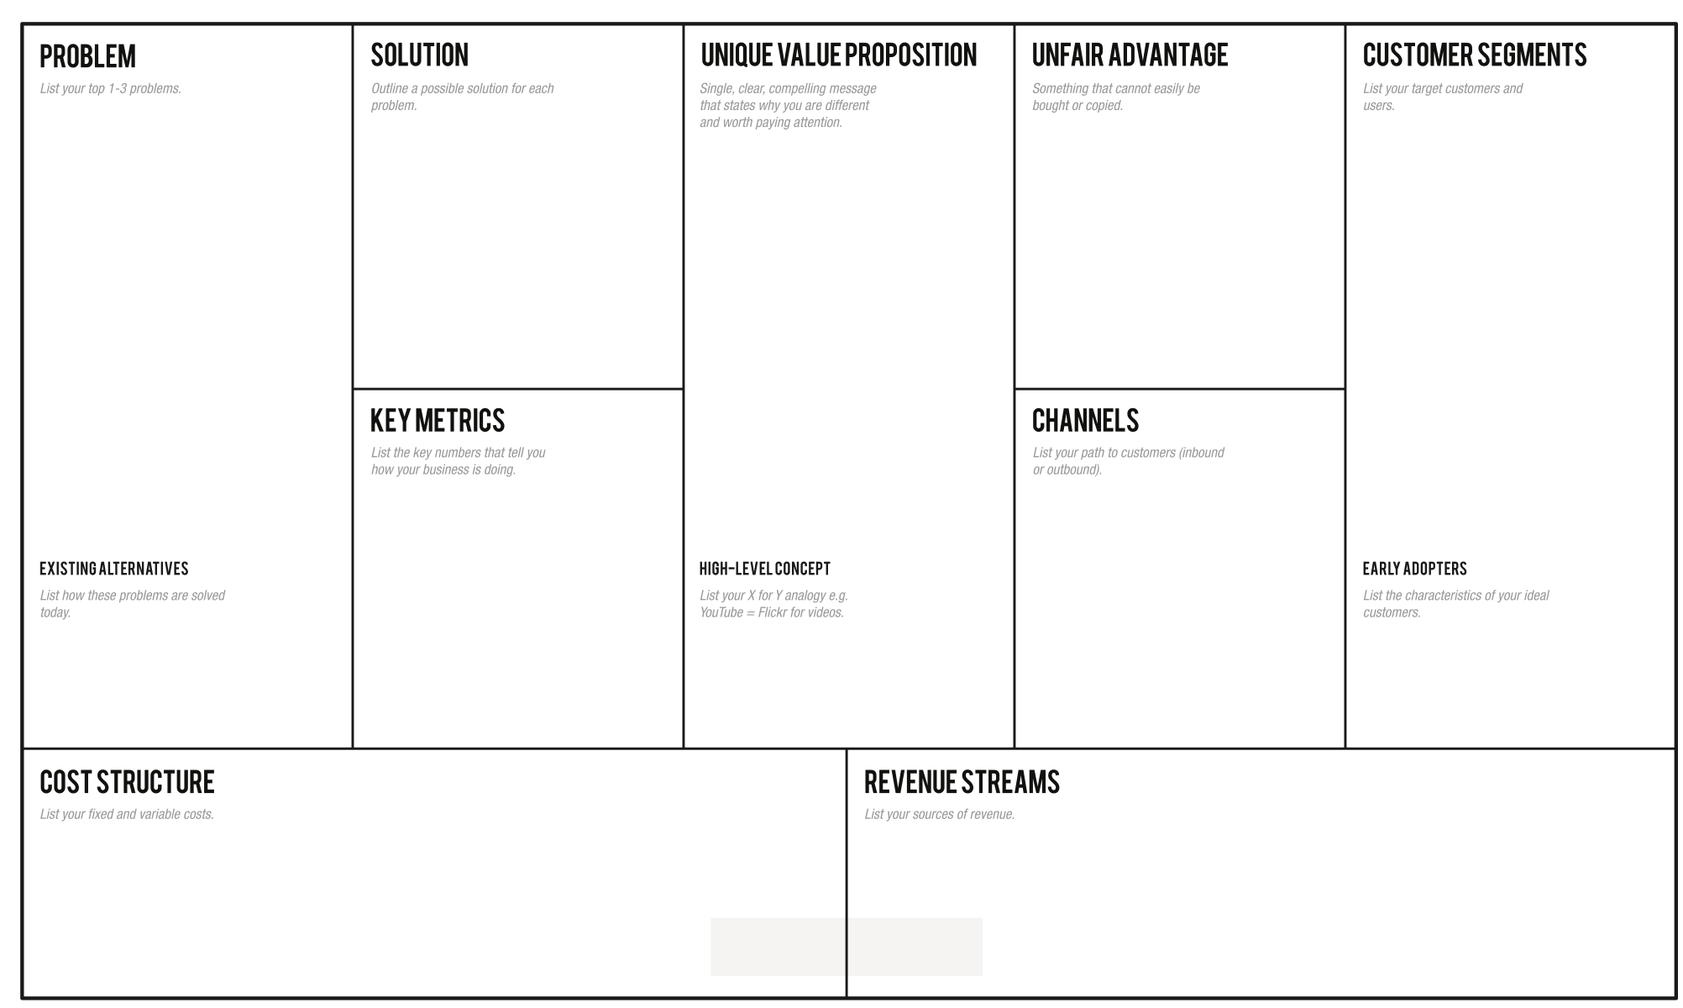
1
Identify Risks, Decisions, and Deadlines
Where do we stand right now? What’s ahead of us?
Rhythm
1x per week
Risks
What’s our biggest concern?
What has the most riding on it?
What’s critical for us to know?
What risks can we live with for now?
Deadlines
What is most time-sensitive right now?
What are the hard deadlines we must hit?
What can give us more flexibility?
What will help us stay on track?
Decisions
Which will address risk and uncertainty?
Which will change our direction most?
Which will affect other decisions?
Which don’t have to be made right now?

Slide 4
2
Create and Prioritize Tasks
What needs to be done? Why? How? What does done mean?
Rhythm
2x per week
READY
DESCRIBING WHAT
What are you really trying to accomplish?
EXPLAINING WHY
What outcome do you hope to have?
DECIDING HOW
Is it clear how we are going to do this?
Are we confident this approach will be effective?
Are we confident we can afford it?
DEFINING “DONE”
How will we know (yes or no) whether
we’ve done what we set out to do?

Slide 5
1=2
EXAMPLE
Creating effective tasks
we need to…
This one-sentence format is great for saying what we want to do
and why…
“We need to so that .”
identify the pain points long commute times cause
so that we can decide if solving it would provide any real value.
WHAT & WHY
After looking at our lean canvas, we realized that we’re still not confident about whether solving the problem we identified (long commutes suck!) is worth solving. We think we should find out more about the pain points the problem causes, because what we really want is to decide whether we’re going to continue working on this problem or pivot in another direction.
but it’s not clear how we would actually do this, so we should probably break it down to something more concrete.
interview potential customers about the long commute time problem
so that we can identify the pain points they feel
HOW
We want deeper understanding of what customers are feeling and thinking… so doing interviews seems like a good way to do that.
but it’s still not clear whom we should interview or how many people we should talk to, so we should probably break it down more.
DEFINING “DONE”
We felt that 5 people from each of the groups we are interested in would be about right. We felt like fewer wouldn’t give us enough information but more would take too much time and effort to be worth it.
talk to 5 people who drive alone about their daily commute
so that we can identify the pain points they feel
talk to 5 people who carpool about their daily commute
so that we can identify the pain points they feel
talk to 5 people who ride the subway about their daily commute
so that we can identify the pain points they feel

Slide 6
3
Get Stuff Done
Manage the flow. Check in often. Make everything transparent.
Rhythm
1-2x per day
READY
DOING
DONE
Moving from Ready to Doing
What should we be doing?
Who can do this?
Who will commit to getting it done?
Moving from Doing to Done
Is the task done? (yes/no are the only valid answers)
IF NO: Is there something blocking you?
How will we fix this… right now?

Slide 7
4
Reflect and Grow
What have we learned? What can we do better?
Rhythm
1x per week
A “starfish” exercise is a great tool for reflecting as a team
Keep Doing
Do More
Do Less
Start Doing
Stop Doing
Celebrate
Let’s recognize the hard work we’ve done and the progress we’ve made.
We deserve it!
Reflect
How did it go? What have we learned?
What we look like from each teammate’s perspective?
What do we want to look like going forward?
How can we be a healthier, happier, more effective team going forward?

